Slide 1
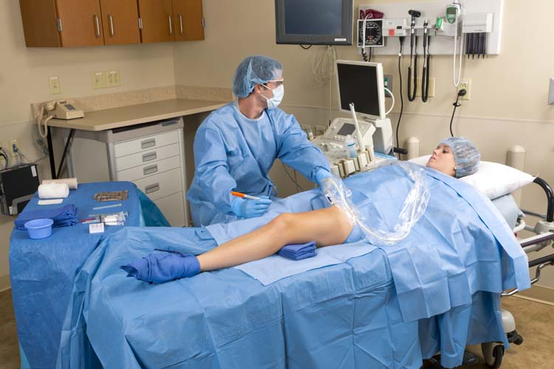
Increase safety and efficiency in your vein clinic

Slide 2
Challenges in the vein clinic
Keeping patients and staff safe
  Tiburon® split drape is designed to protect clinician and patient safety; the drape is classified as AAMI level 4 for barrier performance in the critical zones
  ChloraPrep® and PVP scrub antiseptics help to reduce bacteria that potentially can cause skin infection
Efficiencies
Healthcare practice and change are driving lean practices
Notes:
The intricate nature of endoscopes and their accessories make cleaning a challenge

Slide 3
Vein kits from Presource® Products and Services
Choice of PVP scrub or ChloraPrep® antiseptic
  ChloraPrep® applicator is designed to eliminate direct hand-to-patient contact, which helps prevent cross contamination¹
  PVP scrub is a fast-acting, broad-spectrum antiseptic that helps reduce bacteria that potentially can cause skin infection²
Prep-Safe Skin Marker
  Allows for expert vein mapping with ink that does not fade or smear – even when treated with antiseptic
¹ CareFusion website, http://www.carefusion.com/medical-products/infection-prevention/skin-preparation/

Slide 4
Vein kits from Presource®
Tiburon® Split Drape
Classified as AAMI level 4 for barrier performance in the critical zones - engineered to pass these industry standard tests that measure fluid and synthetic viral penetration, which help protect clinician and patient safety within the critical zone
Resistant to abrasion and puncture, yet their flexible, cloth-like properties allow them to drape naturally, following the contours of the patient
Drape is split with adhesive, 6” x 40” for easy exposure of one leg at a time
Convenience kits
  Reduce time and expense of ordering, stocking and picking multiple items – and eliminate waste by pulling the right kit

Slide 5
Procedural coverage
Procedures requiring treatment of varicose and spider veins, such as:
Vein Ablation
Sclerotherapy
Phlebectomy

Slide 6
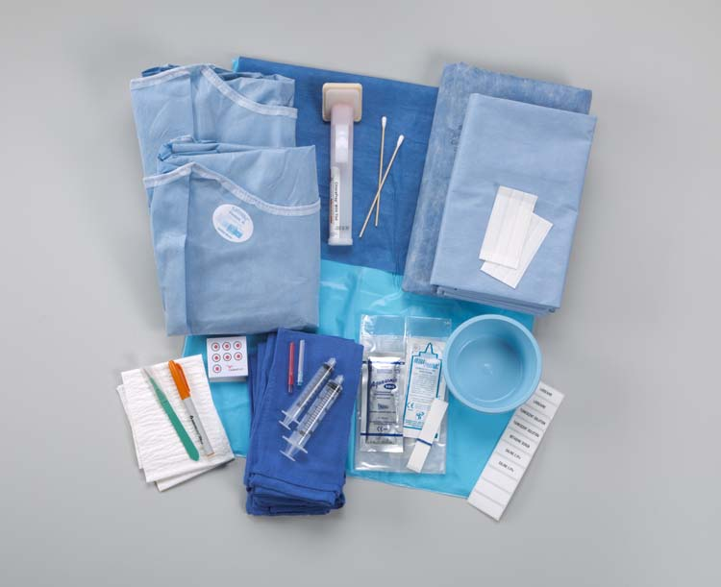
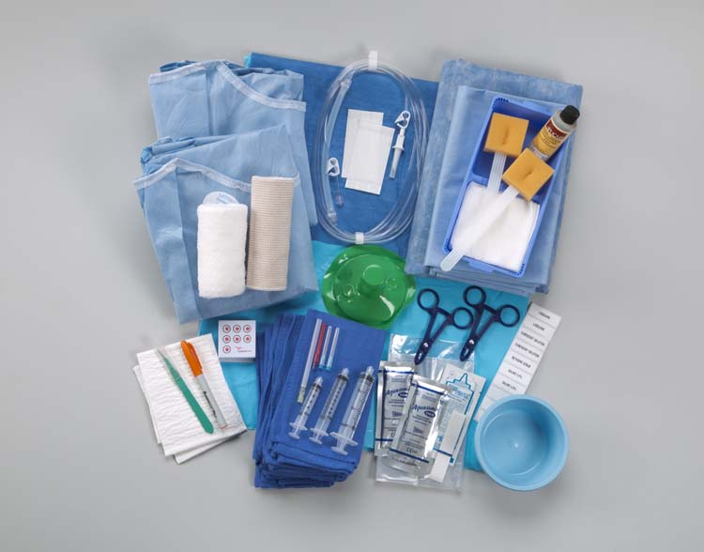
Product offerings: four standard kits

Slide 7
To learn more
Contact your Presource® Products and Services sales representative at 800.964.5227, or email PresourceSolutions@cardinalhealth.com to see how our standard and custom vein kits can improve your vein clinic room turnover and patient efficiency.

Slide 8
Thank you!

